Slide 1
Engagement Showcase
Ahmed Kheiri
9 December 2020

Slide 2

Real-World Industry Project Introduction
Employability
Employability is currently an important focus for universities
It influences the rankings of universities which drive student recruitment in the UK
Teaching and assessing real-world skills, are undoubtedly important for future employability

Slide 3
Why engage with industry for teaching and assessment purposes?
Improving employability of our students
Increasing student engagement and enthusiasm for topic
Demonstrating relevance to practice
Students as ‘consultants’ or ‘experts’
Enabling teaching-based research?
Students as ‘researchers’

Slide 4



Real-World Industry Project ORTEC Project

Slide 5
Real-World Industry Project ORTEC Project for MSCI517
Project-based assessment tends to be fairly large scale, covering all aspects of the identified learning outcomes, with a fairly generous maximum timeframe set for completing them
For MSCI517, the project tasks were designed such that they can be solved by the majority of the students but generate challenges for more advanced students
The project included open-ended elements to encourage students

Slide 6
Real-World Industry Project Pros
The students were operating in an environment that is close to reality
The project gave the students a strong sense of accomplishment as they have generated a real application
The students were motivated to complete the work for grade, in addition to the fact that they appreciated the opportunity to connect their creativity with programming

Slide 7
Real-World Industry Project Cons
Students are penalised if they are unable to spend enough time completing the tasks
Project-based assessment is more vulnerable to plagiarism than other assessment methods

Slide 8
Knowledge Transfer Partnership
The Knowledge Transfer Partnership scheme helps businesses in the UK to grow
The academic partner will help to develop the project, provide academic input and recruit an associate
The scheme can last between 12 and 36 months

Slide 9



Knowledge Transfer Partnership Optrak
Developing and implementing techniques for routing problems

Slide 10
Consultancy Service
Consultancy is the provision of expert advice based on existing knowledge
The University provides a managed service for consultancy, supporting pricing, negotiating, contracting and invoicing

Slide 11

Consultancy Service NWAA – Project 3

Slide 12

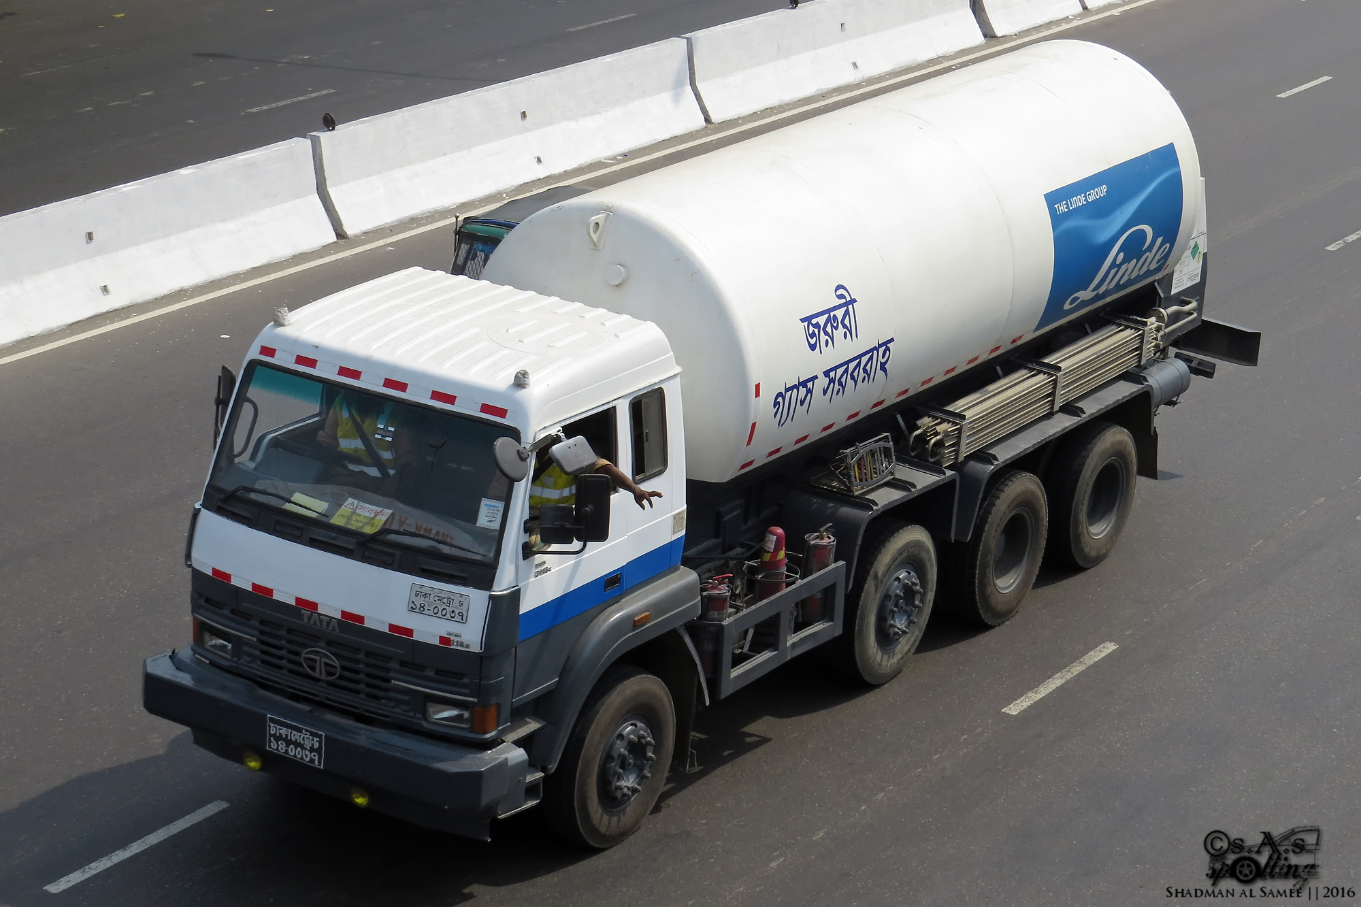

Consultancy Service Linde
Drivers – Trailers – Customers (VMI, Call-in) – Multi-products – Sources – Depots – Multi-trip routing
huge number of customers over long time horizons
starting times can be at any time of the day
quantities to refill
routing of trailers
scheduling of drivers
non-linear objective function (logistics ratio)

Slide 13
Benefits
Knowledge exchange
Creating impact
Research publications
Extending networks
Informing new research ideas

Slide 14
References
https://www.gov.uk/guidance/knowledge-transfer-partnerships-what-they-are-and-how-to-apply
https://www.lancaster.ac.uk/research/research-enterprise-services/consultancy/

Slide 15
Thank you for your attention!

